Slide 2
A Dream to Create the Future
Vision
With a focus of expansion on a global platform along with value addition to healthcare and life.
Mission
Practising an innovative approach for consistent quality through appropriate groundwork, distinctive strategy and technology.

Slide 3
3

Slide 4
A Penchant for Excellence
An ISO 9001:2015 & GMP Certified Company
Leading manufacturer of Pharmaceutical Excipients
- Microcrystalline Cellulose (MCC)
- Cross Carmellose Sodium (CCS)
- Magnesium Stearate (MS)
- Cellulose Powder (CP)
Fully automated Plant at Dahej SEZ with an installed capacity of 12,000 MT p.a.
State of the art plant at Pirana, Gujarat with an installed capacity of 2000 MT p.a.
Having modern classed RCC structure under controlled airflow supplied with clean filtered air.
Turnover in the financial year of 2017-2018 is about 14 Million USD of Accent.
4

Slide 5
Quality Policy
Accent Microcell Private Limited shall ensure to provide high-quality products to our customers through constant improvement in
manufacturing process, use of
high-quality material & stringent
quality control.
Customer satisfaction with on-time committed delivery is our main motto.
The policy is being reviewed for continued suitability from time to time.
5

Slide 6
A Wide Range of Products
The Company has specialized expertise in manufacturing and marketing a wide range of Pharmaceutical Excipients. We manufacture and market the following :-
Micro Crystalline Cellulose (MCC):
Accel 101
Accel 102
Accel 103
Accel 105
Accel 12
Accel 112
Accel 113
Accel 200
Accel 301
Accel 302
Cross Carmellose Sodium (CCS)
Magnesium Stearate (MS)
Cellulose Powder (CP)
6

Slide 7
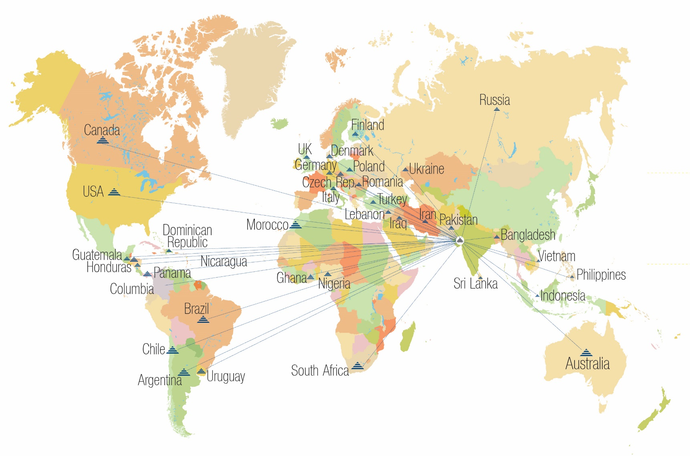
Expansion at a Lightning Speed with a
Global Reach
7

Slide 8
Wide Clientele Across the Globe
…….. and many more
8

Slide 9
Accolades to Our Credit
GMP
ISO 9001:2015
FSSC-22000
FSSAI
KOSHER
HALAL
USP/NF, EP, JP, BP, IP
US-DMF (29617)
9

Slide 10
Glorious Journey Spread over Decade
2018 Excipact Certification Planned
2016 FSSC 22000 certificate obtained.
2015 Extensive Global Expansion through Agreements
2014 Installed Metal detector at Dahej Plant
2013 New Plant at Dahej with installed capacity : 12000 MT/Annum
2012 Company Converted into Private Limited.
2011 GMP Certificate obtained.
2010 Microbial lab set up to meet international standards.
2009 Technology up-gradation relevant to quality as well as quantity.
2008 Considerable global presence established.
2006 Other Excipients range included in the product portfolio.
2005 Economic MCC Grade Established.
2004 ISO 9001 Approval.
2001 Incorporation of the Company.
10

Slide 11
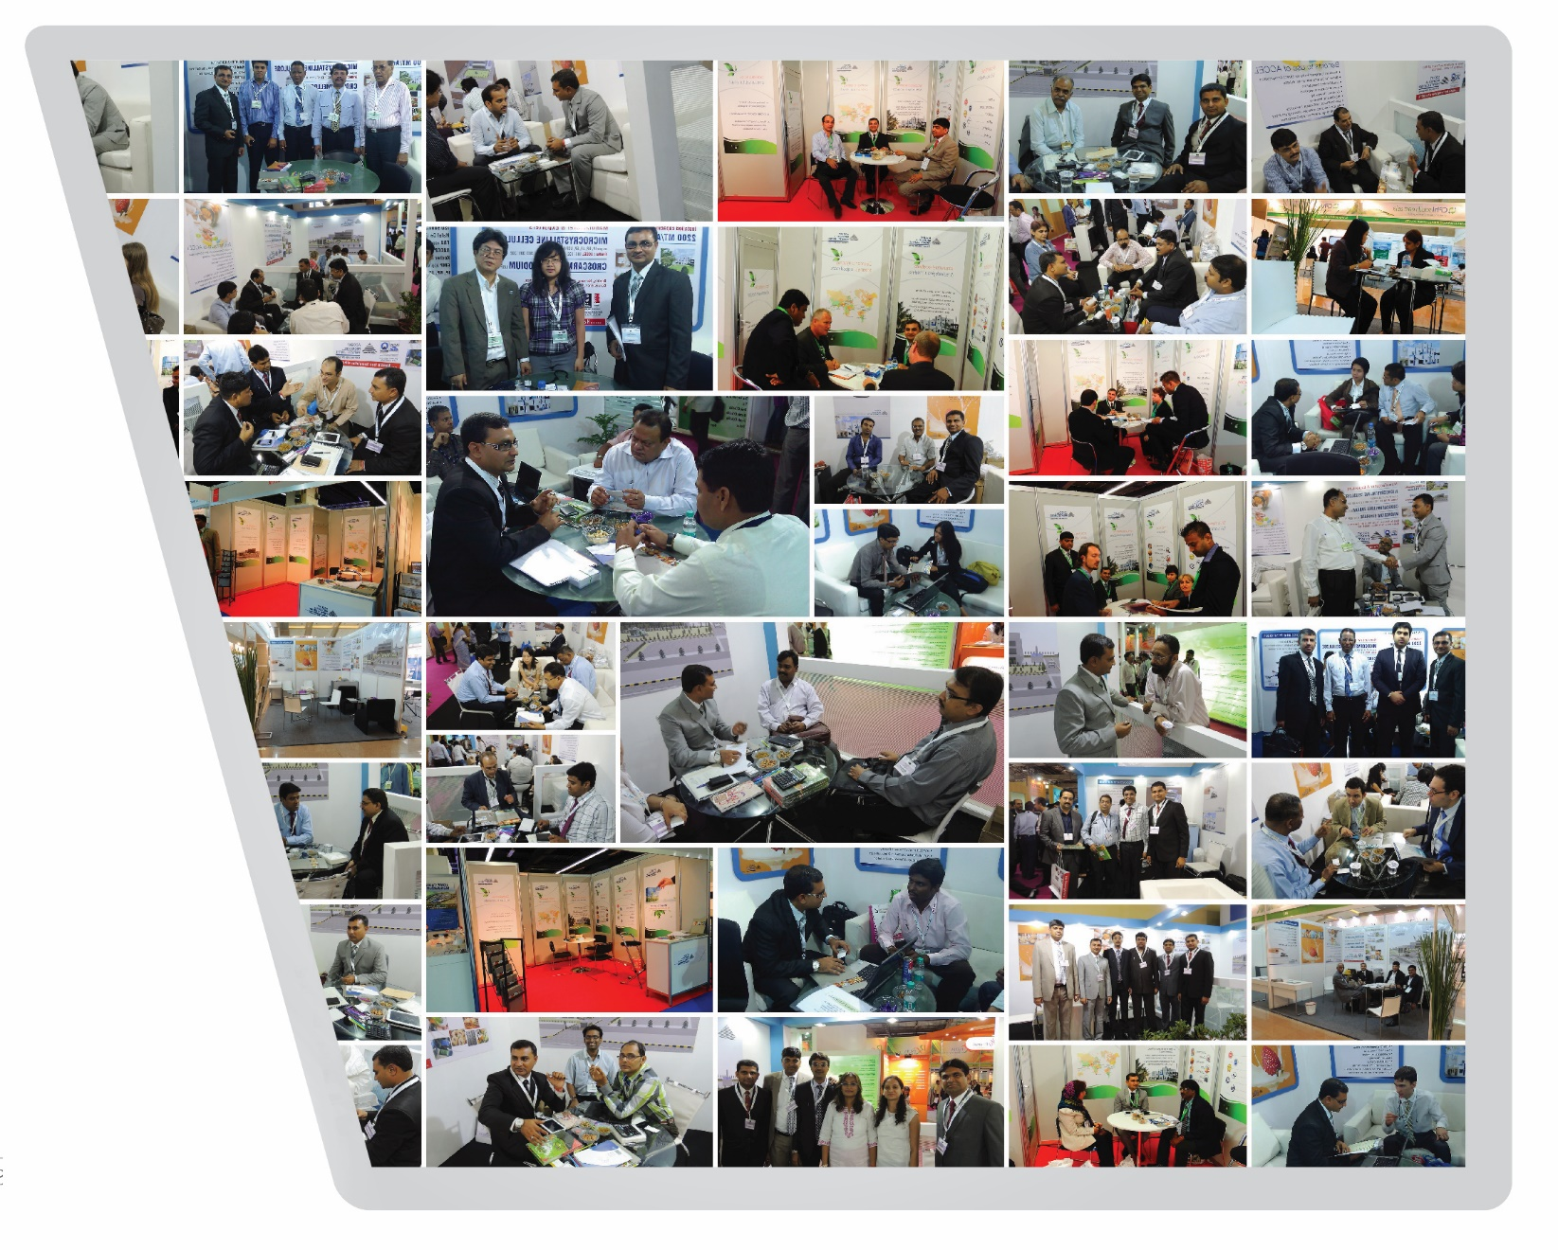
Participation in CPHI worldwide
Pharma, Food & Neutraceuticals
11
11

Slide 12
Products
Micro Crystalline Cellulose Microcrystalline Cellulose is a term for refined wood pulp and is used as a texturizer, an anti-caking agent, a fat substitute, an emulsifier, an extender, and a bulking agent in food production. The most common form is used in vitamin supplements or tablets. It is also used in plaque assays for counting viruses, as an alternative to carboxymethylcellulose.
12

Slide 13
Benefits of usage of MCC
Excellent Compressibility for Direct Compression.
Better for Spheronization for Pellets
Good for wet Granulation
Less usage of lubrication is required
Excellent Flowability
High Dilution Potential
Low Coefficient of Friction / Friability
Multiple functions as Binder-Disintegrate-Filler
Optimum range of Particle Size Distribution
13

Slide 14
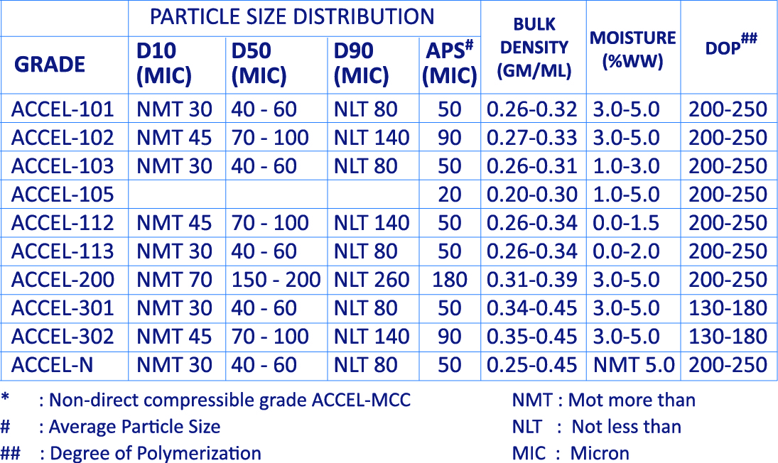
Specification : Micro crystalline Cellulose
14

Slide 15
Cross Carmellose Sodium (Rapid Disintegrate)
Cross Carmellose Sodium of ACCENT is available by the brand name ACROCELL.
It is an internally cross-linked polymer of Sodium Carboxy Methyl Cellulose.
It reduces solubility of the water.
The nature of Cross linked makes it an insoluble, hydrophilic, highly absorbent material, resulting in excellent swelling properties and its unique fibrous nature gives it exceptional water wicking capabilities.
It provides superior drug dissolution and disintegration characteristics, thus improving bioavailability of formulations.
ACROCELL is a white to off white granular powder and a superior tablet disintegrator.
15

Slide 16
Benefits of Cross Carmellose Sodium
Rapid disintegrator in pharmaceutical formulations for tablets, Capsules and Granules. ACROCEL CCS is effective for combination with both insoluble and filler-binders, such as MCC and DCP.
It is also preferred for non starch base formulation product.
Tablet dissolution can be greatly increased by the use of a super disintegrant.
Efficient for low use of levels.
Used in both Direct compression (Up to 5%) and Wet granulation (Up to 3%)
Insensate hardness of tablet. Used in Solid dosages Vitamin and Nutrition.
Finer dissolution stability for long term.
16

Slide 17
Magnesium Stearate (Lubricant)
It has the chemical formula Mg(C₁₈H₃₅O₂)₂. It is a salt containing two equivalents of Stearate (the anion of Stearic Acid and one Magnesium cation (Mg²⁺).
White, very fine, light powder, greasy to the touch
Practically insoluble in water and in ethanol
Not soluble in water
Very quiet odour of Stearic Acid
Solid at room temperature
Chemical Formula : C36H70MgO4
Melting Point : 20-130ºC
It contains not less than 4.0% to 5.0% of Magnesium
17

Slide 18
Applications of Magnesium Stearate
Used as a lubricant in Tableting & Pharmaceuticals
Used in paints and varnishes as a flattening agent
Soothing agent in Talcum Powder & Cosmetics
Stabilizer & Lubricant in Engineering Plastics
As a stabilizer and lubricant for plastics
Emulsifying agent in cosmetics
An anti-caking agent in foods
18

Slide 19
Packing
Pack size: 20/25 KGS with an options of:
Export worthy Paper bags
Corrugated Box
Fiber Drums
HDPE Drums
Customized Packing is available as per requirement of Customer.
All above packing options is with LDPE inner liner.
Storage containers are tightly closed under low moisture and heat conditions. The containers are kept in a cool and well-ventilated area and being stored under room temperature.
19

Slide 20
.
Packing
Sr. NO | Packing Type | 20' Container |  |  |  | 40' Container
 |  | No. of packing material | Pallets in No. | Qunatity (KG) in each pallets | Total Quantity (KG) | No. of packing material | Pallets in No. | Qunatity (KG) in each pallets | Total Quantity (KG)
1 | 20 kg paper bag | 500 | 20 | 500 | 10000 | 1000 | 40 | 500 | 20000
2 | 20 kg carton box | 270 | 10 | 5400 | 9000 | 540 | 20 | 10800 | 18000
 |  | 180 | 10 | 3600 |  | 360 | 20 | 7200
3 | 25 kg carton box | 450 | 20 | 450 | 9000 | 900 | 40 | 450 | 18000
4 | 25 kg fibre drum | 160 | 10 | 400 | 6000 | 640 | 40 | 400 | 16000
 |  | 80 | 10 | 200
5 | 25 kg HDPE drum | 160 | 10 | 400 | 6000 | 640 | 40 | 400 | 16000
 |  | 80 | 10 | 200
20

Slide 21
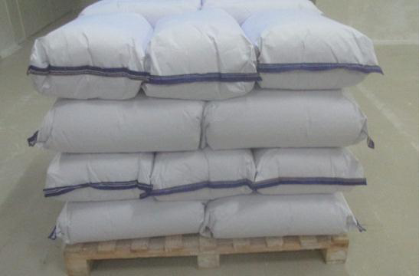
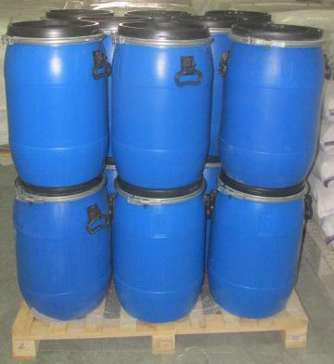
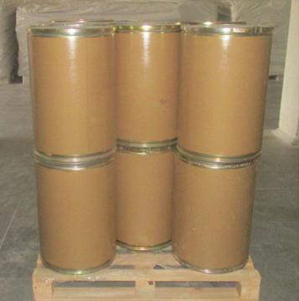
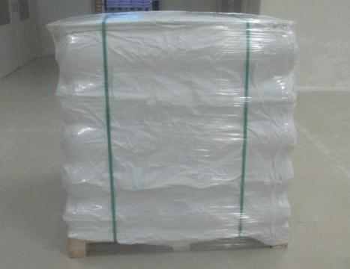
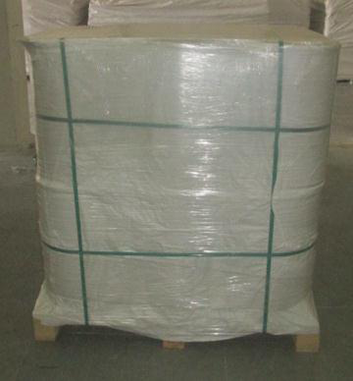
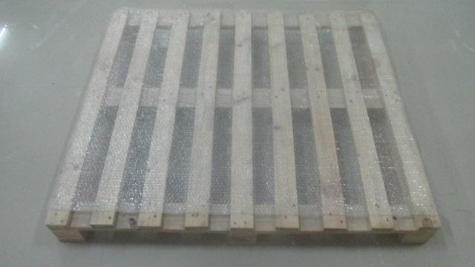
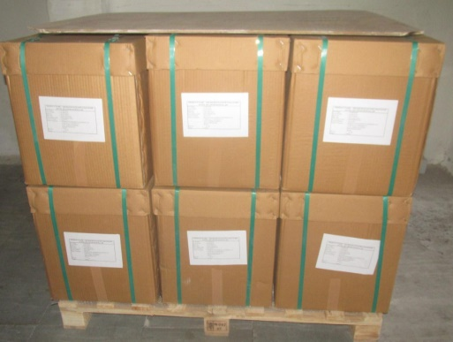
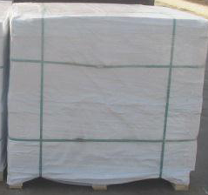
Various Packaging Options
HDPE Paper Bag with LDPE Inner Liner
HDPE Drum packing
Fiber Drum Packing
Ready to Dispatch Pallet - Paper Bag
Ready to Dispatch Drum Pallet
Heat Treated Wooden Pallet
Carton Box Packing
Ready to Dispatch Carton Box Pallet
21

Slide 22
A Wide range of Applications across Sectors
Pharmaceuticals, Cosmetic, Neutraceutical, Food, Welding Electrodes, Tyres, Paint, Cement & Ceramics, Filtration Aid, Enzymes
22
22

Slide 23
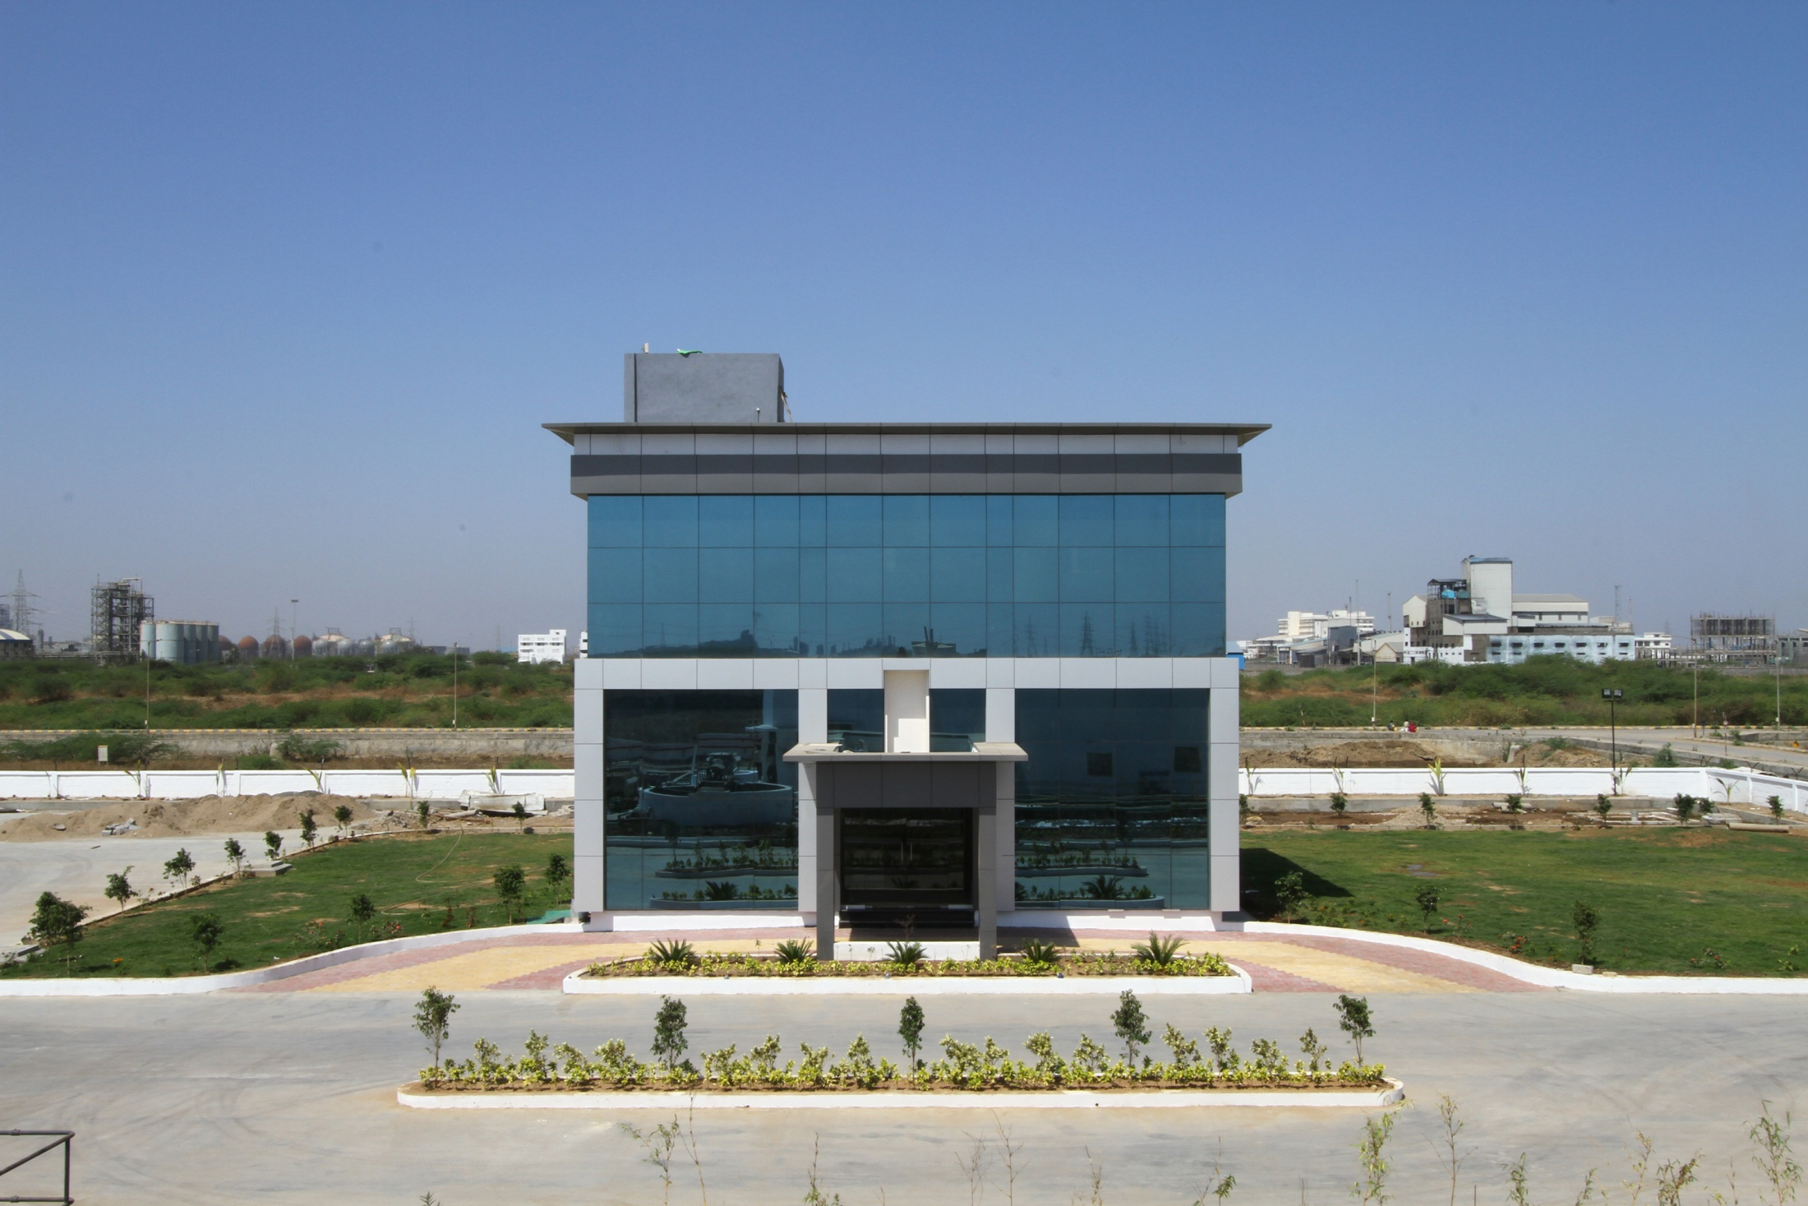
Admin Office
23

Slide 24
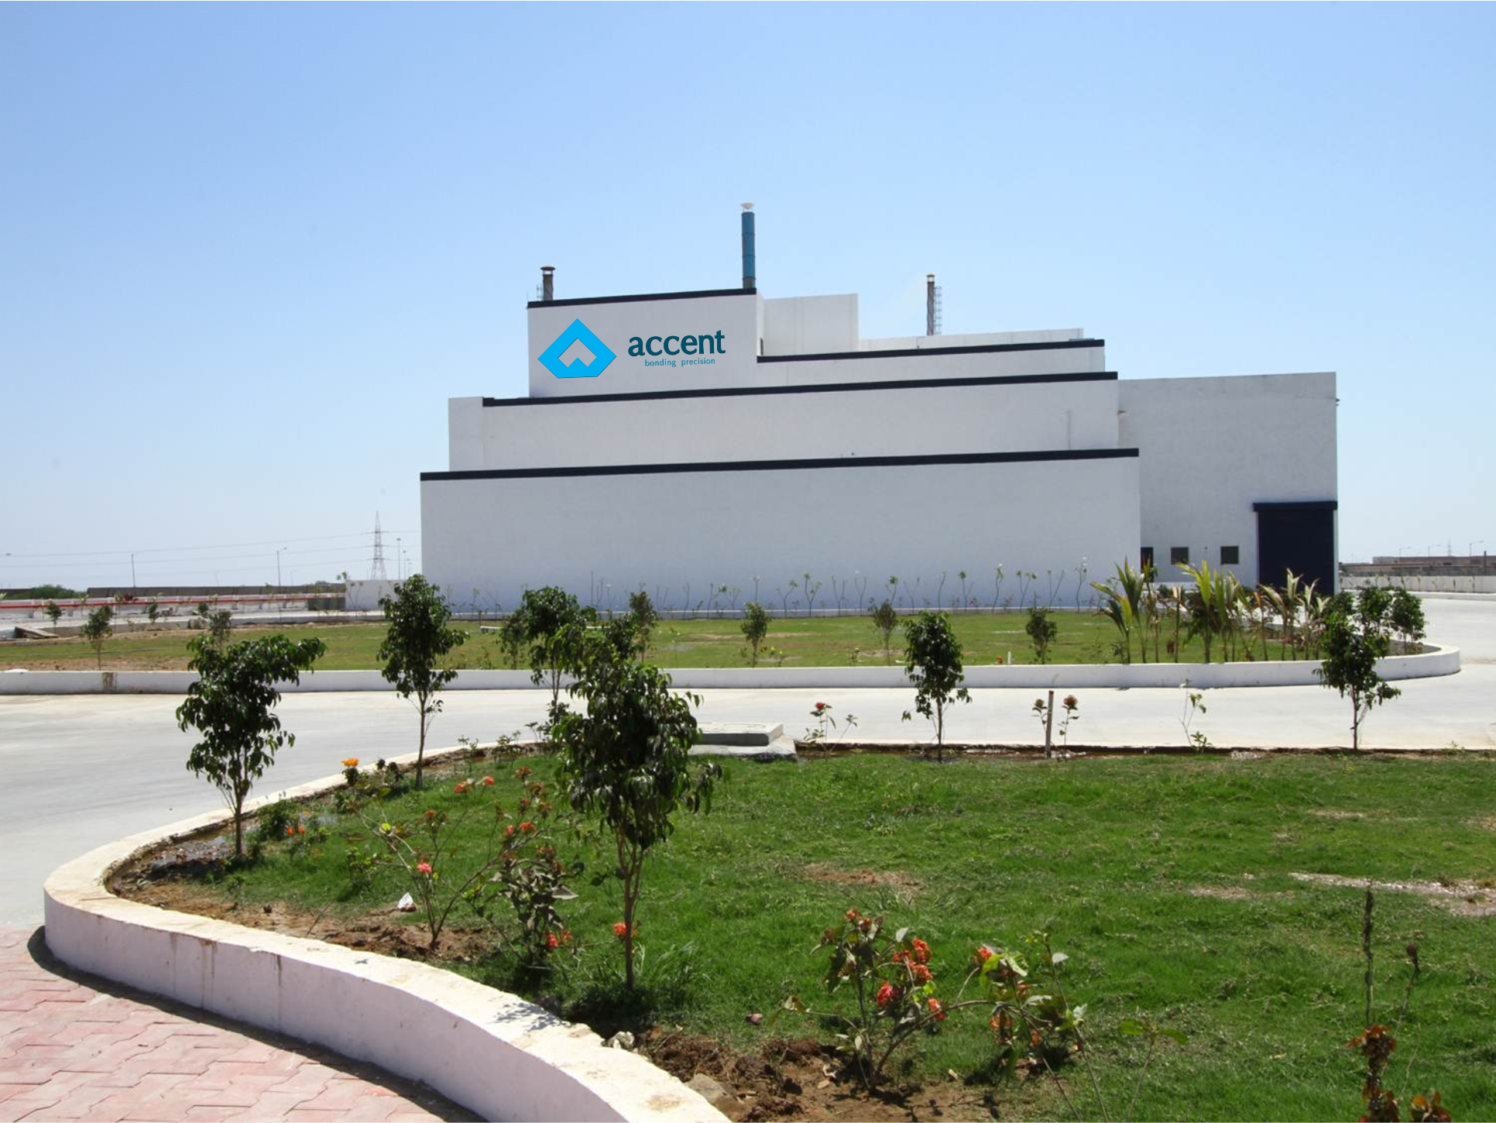
Factory Garden View
24

Slide 25
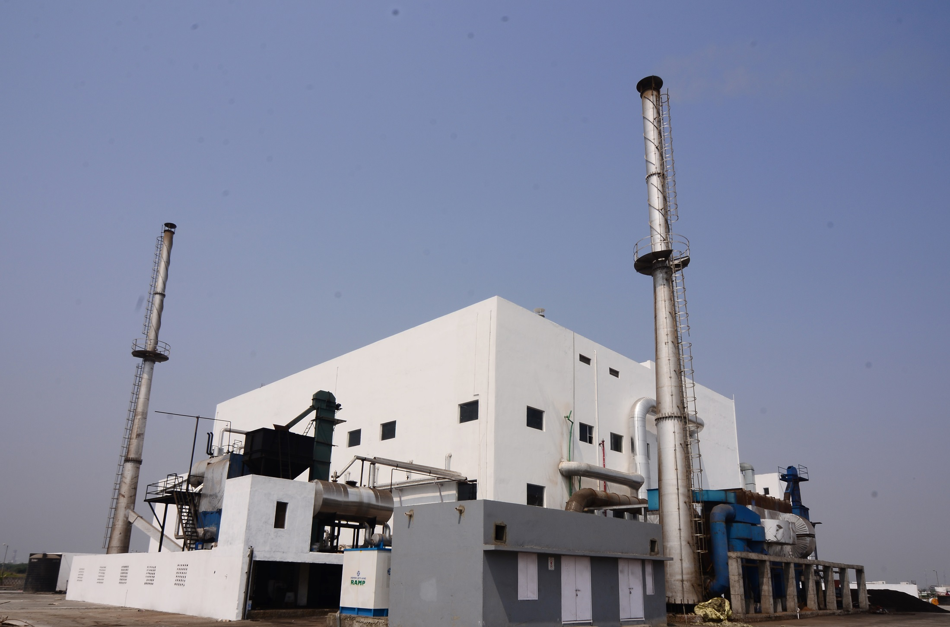
Boiler Unit
25

Slide 26
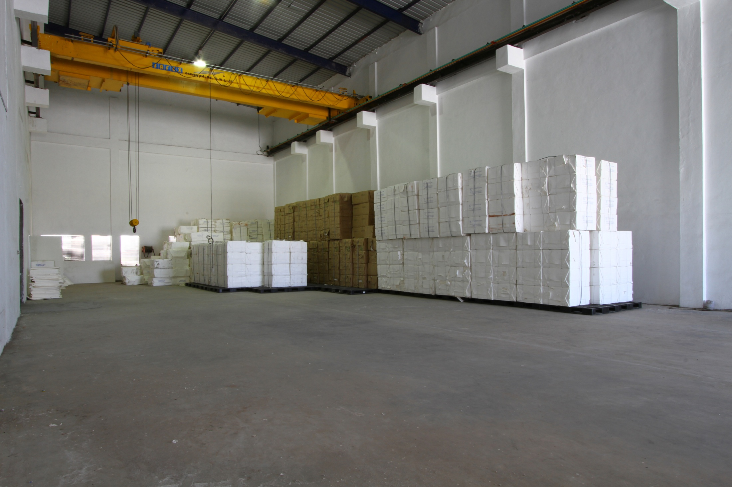
Raw Material Storage Area
26

Slide 27
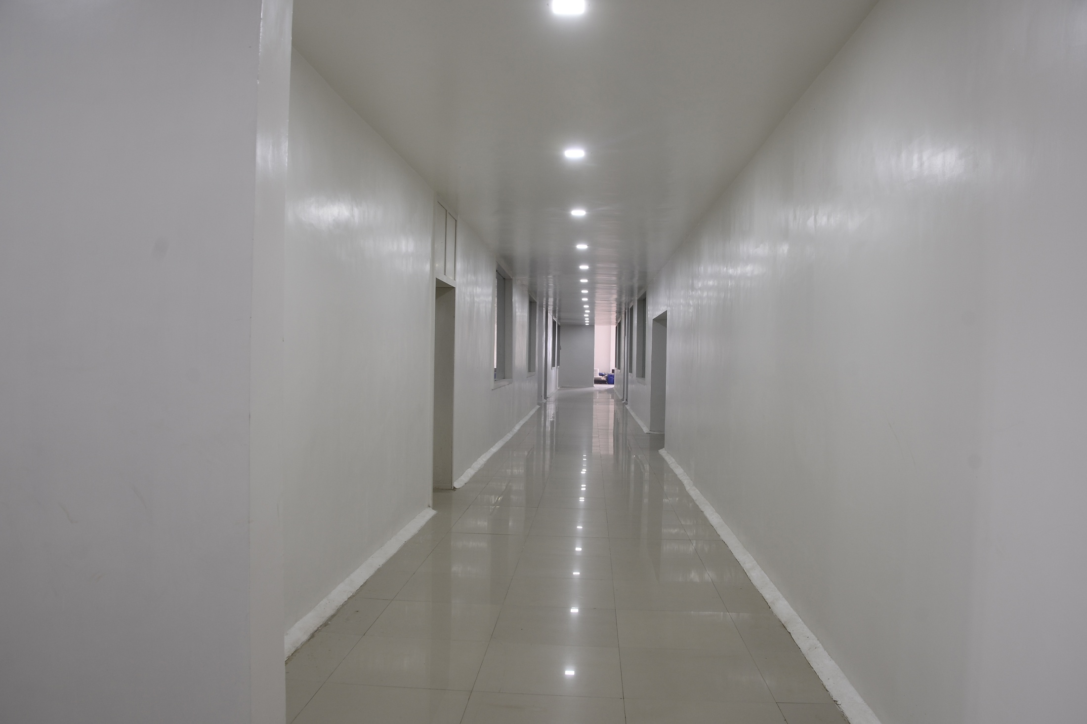
Passage Area
27

Slide 28
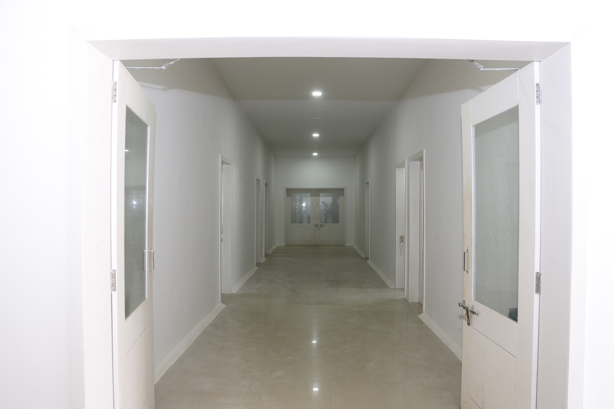
Passage Area
28

Slide 29
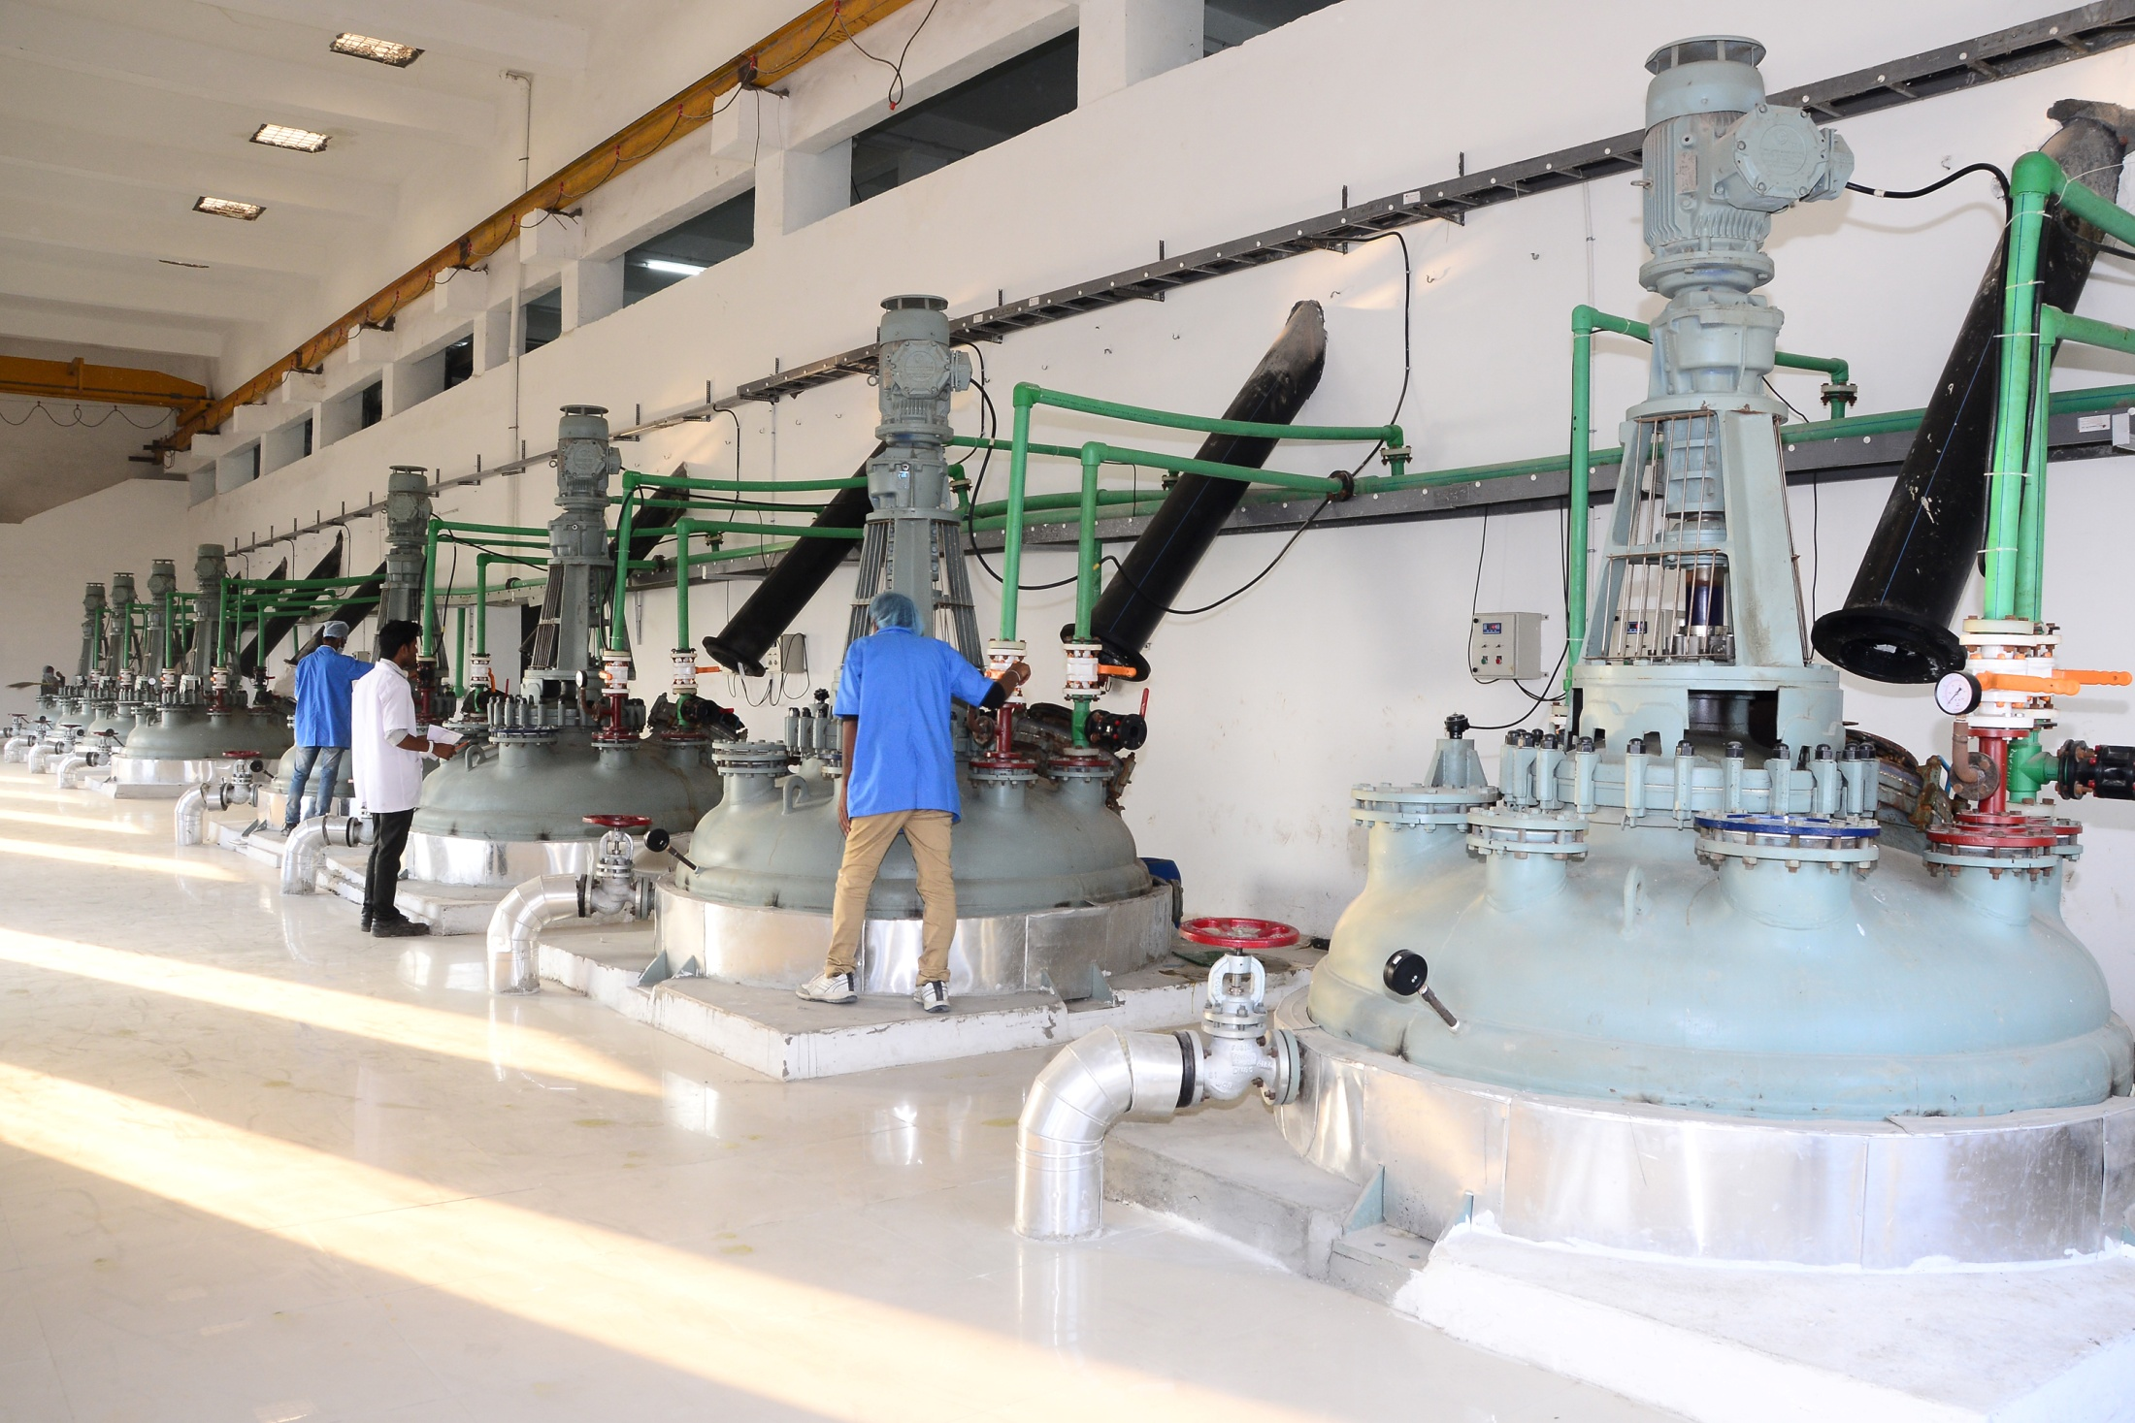
Wet Section
29

Slide 30
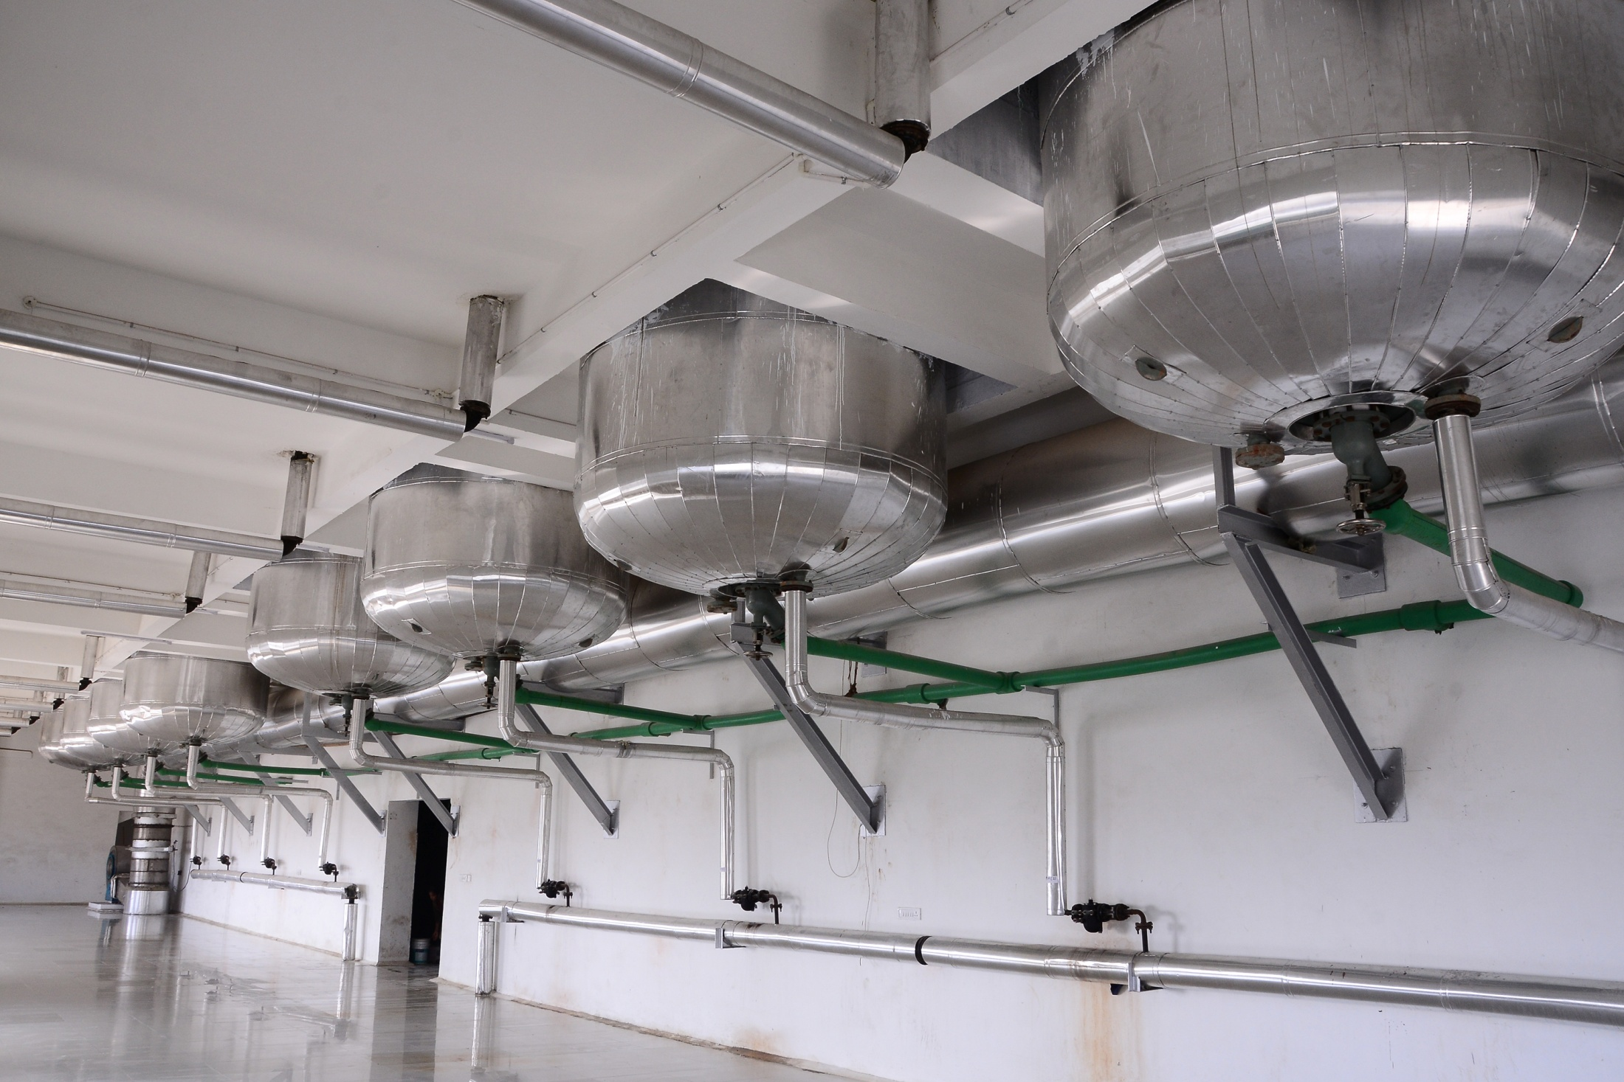
Wet Section
30

Slide 31
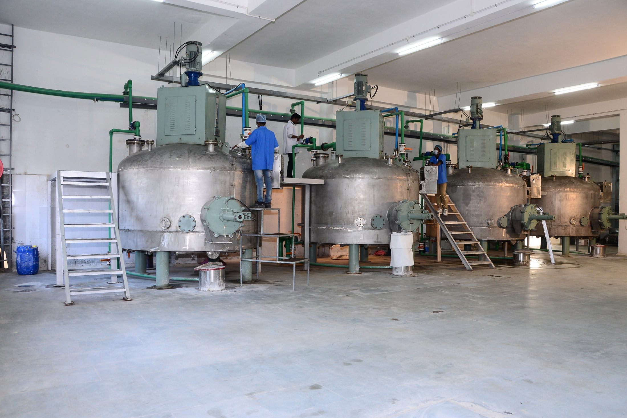
Wet Section
31

Slide 32
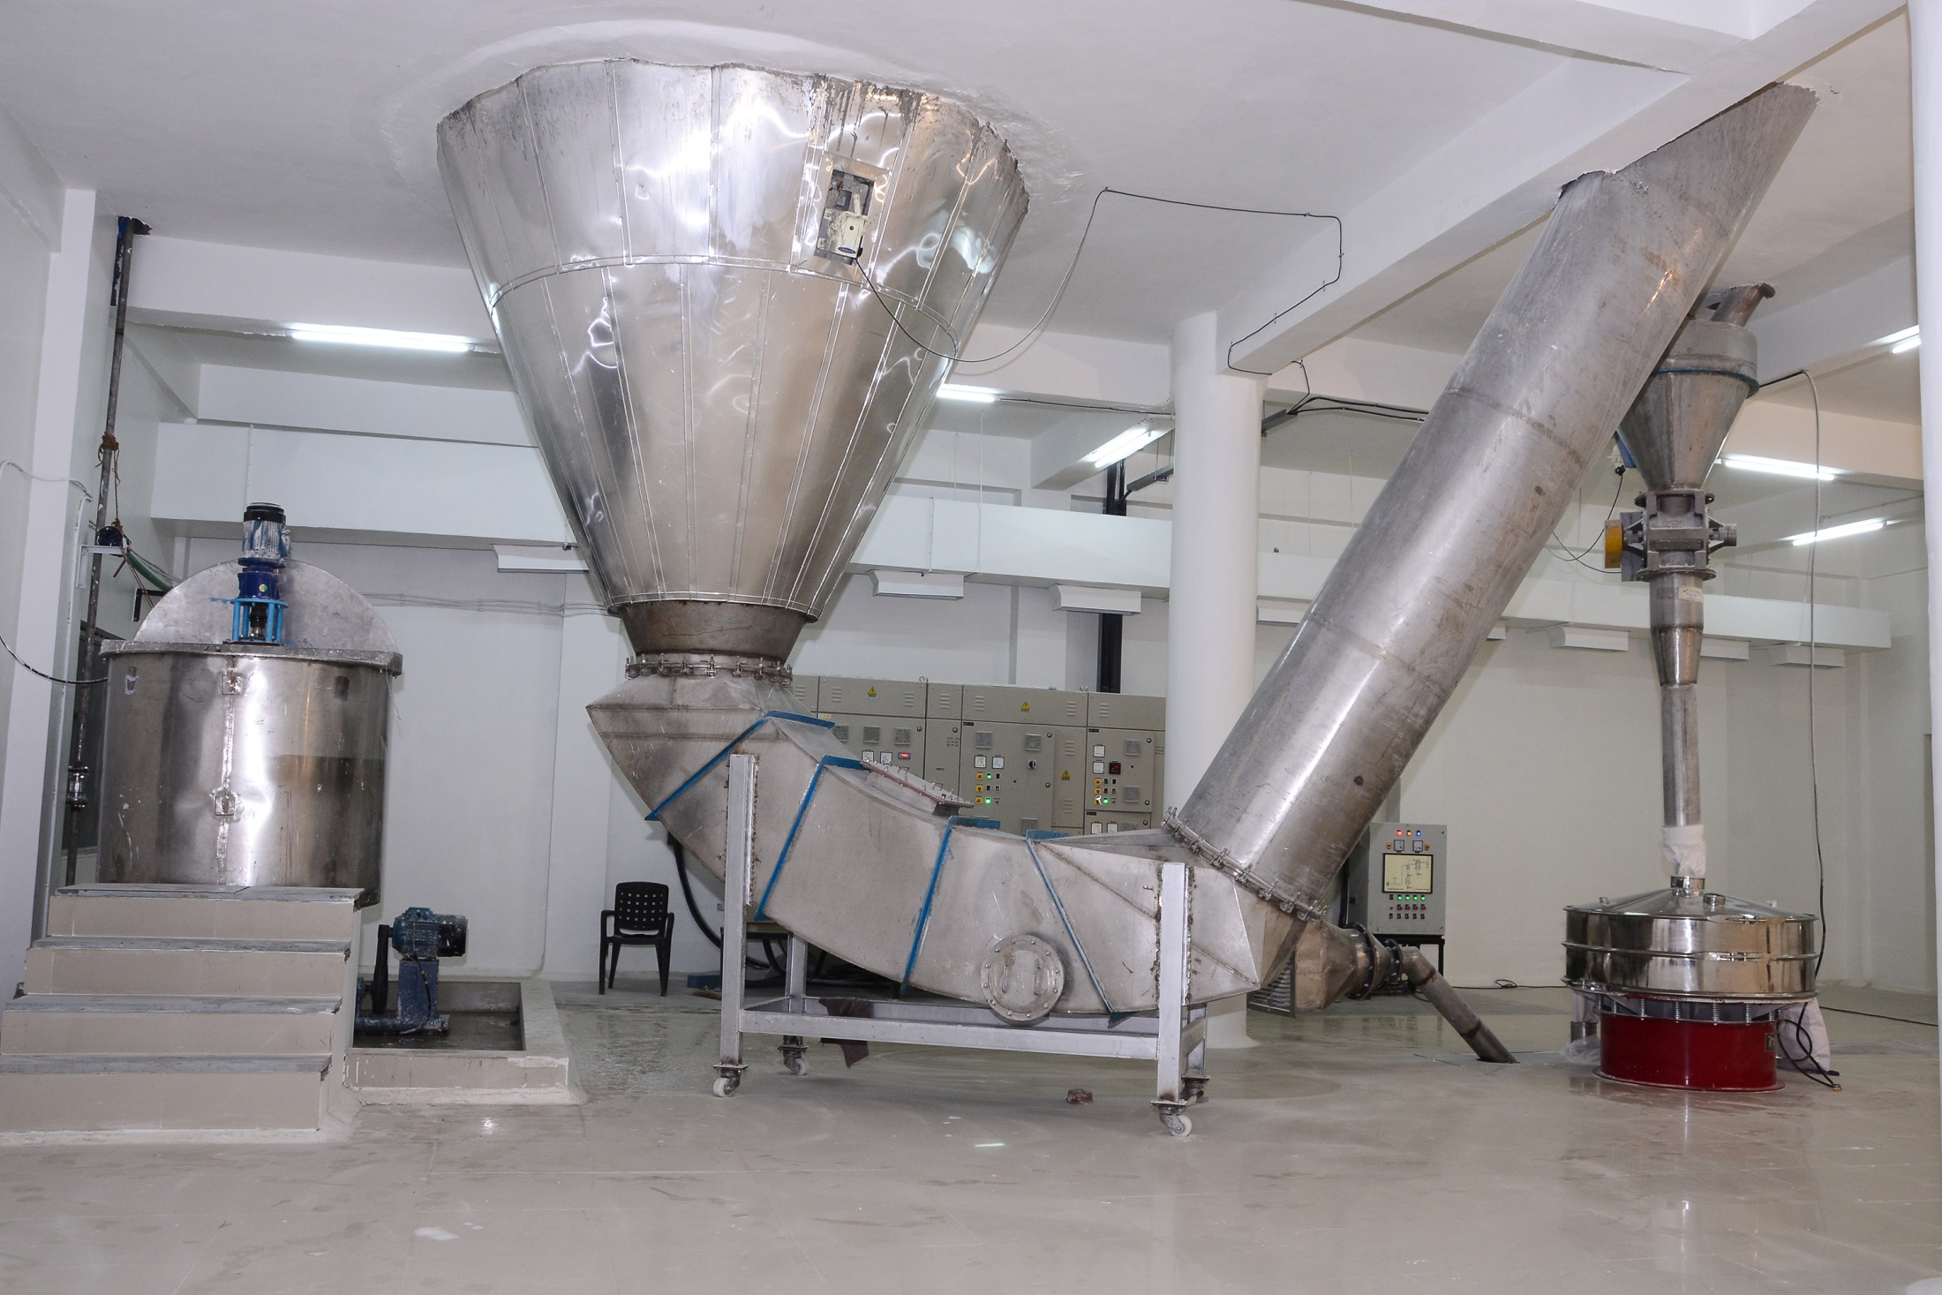
Spray Dryer

Slide 33
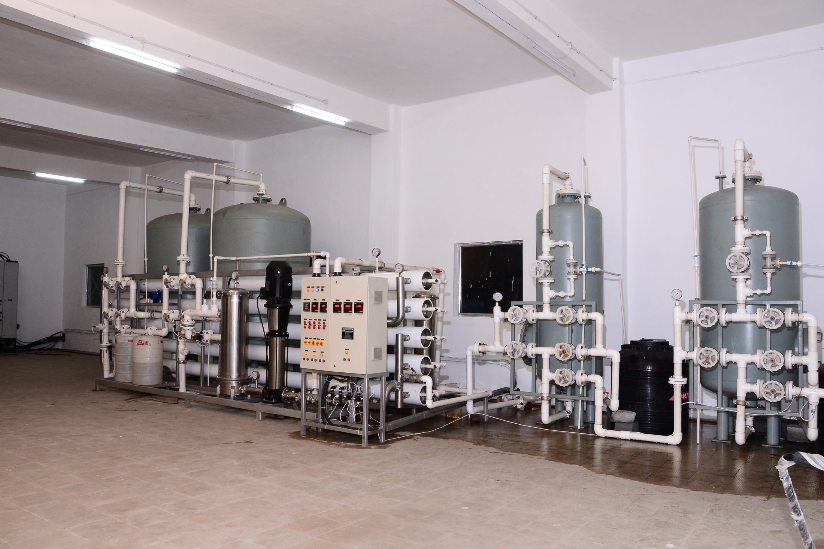
Water Purification Area
33

Slide 34
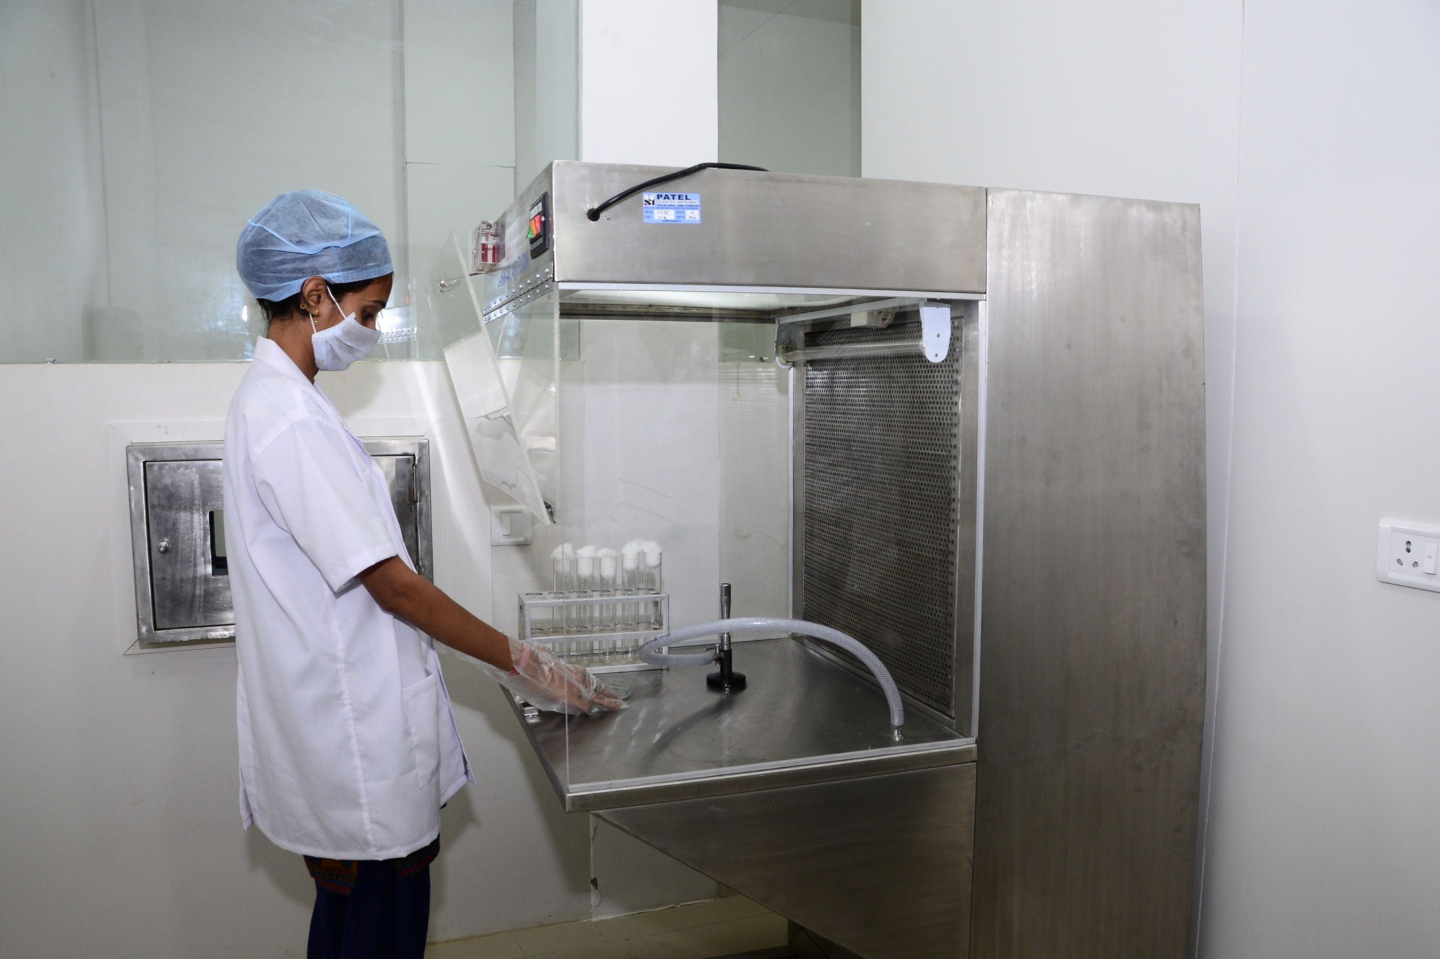
Micro Lab
34

Slide 35
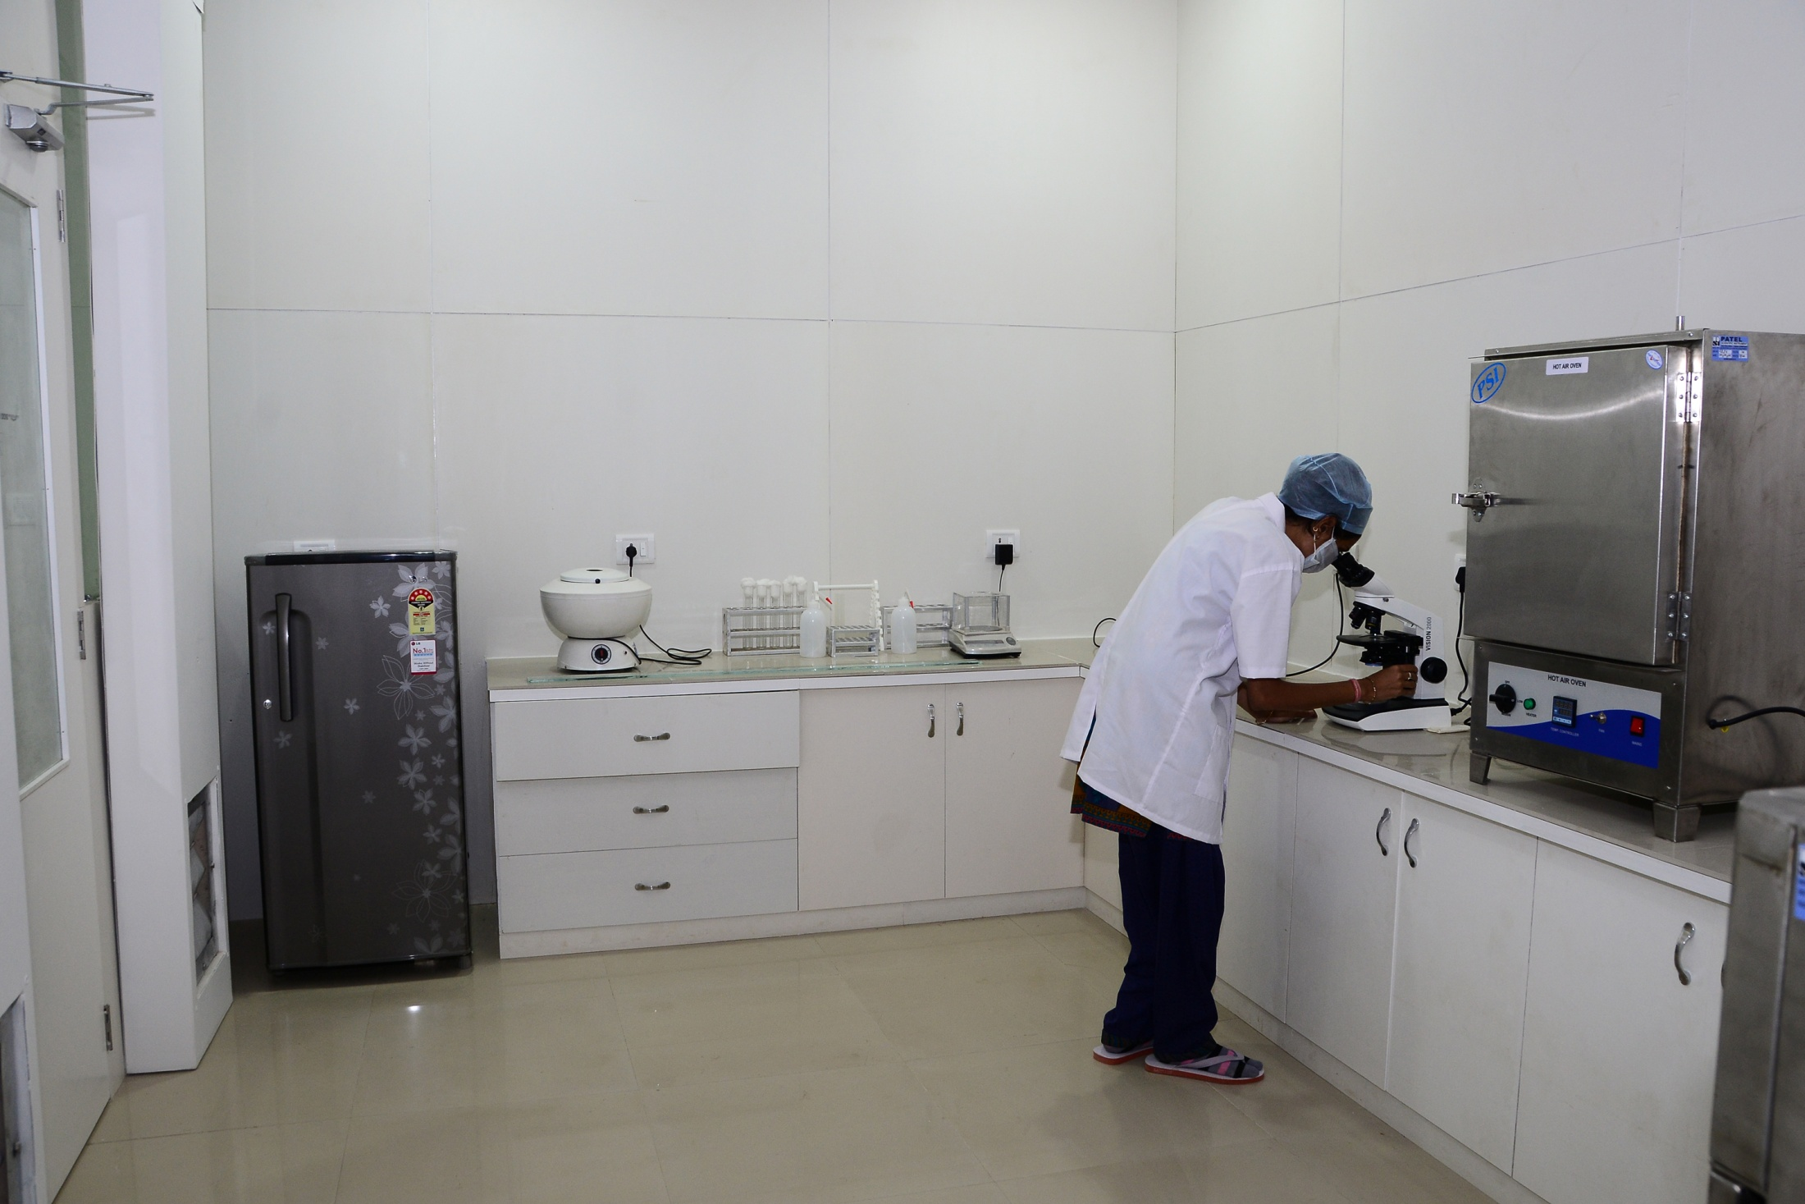
Micro Lab
35

Slide 36
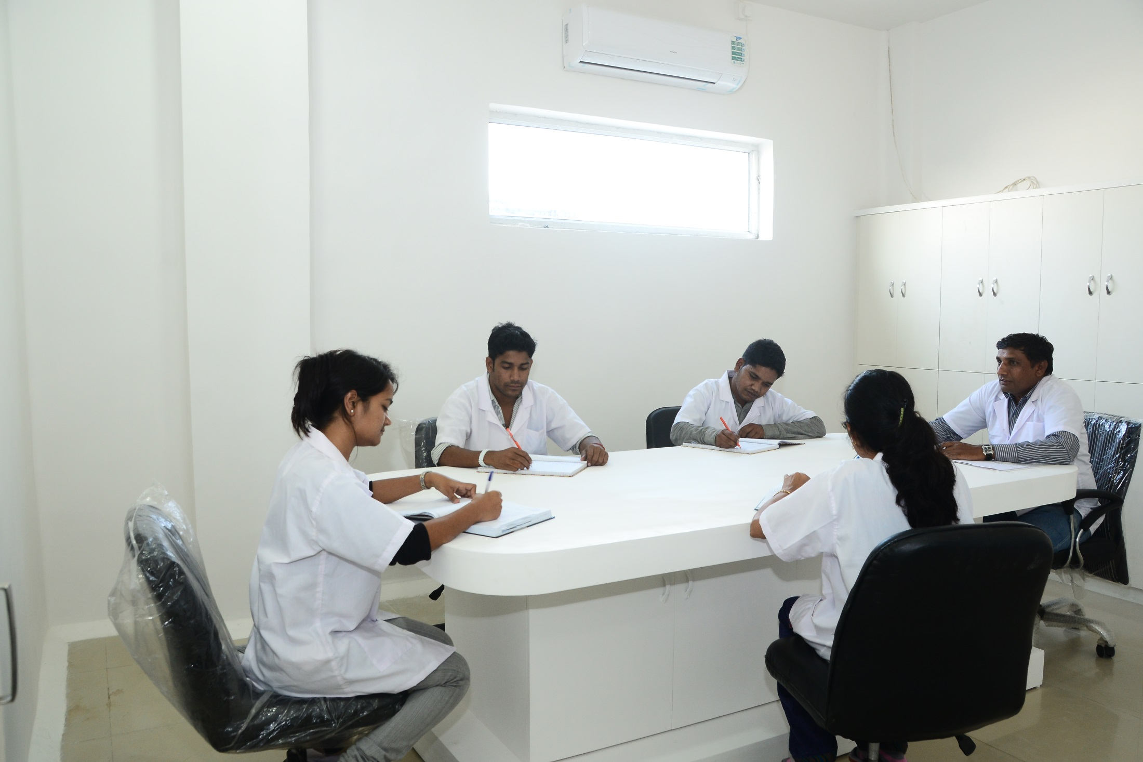
Meeting Room
36

Slide 37
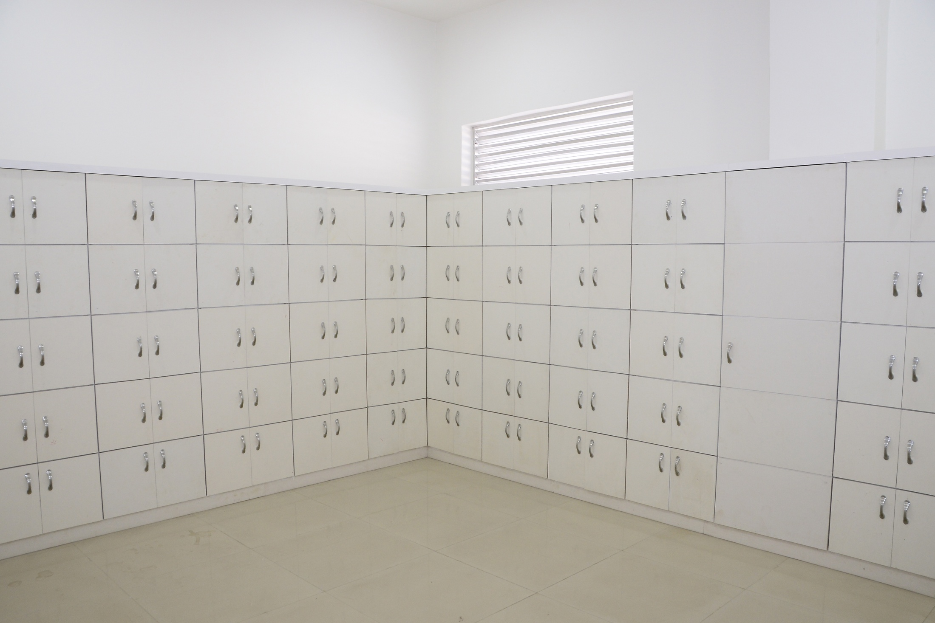
Sample Retain Area
37

Slide 38
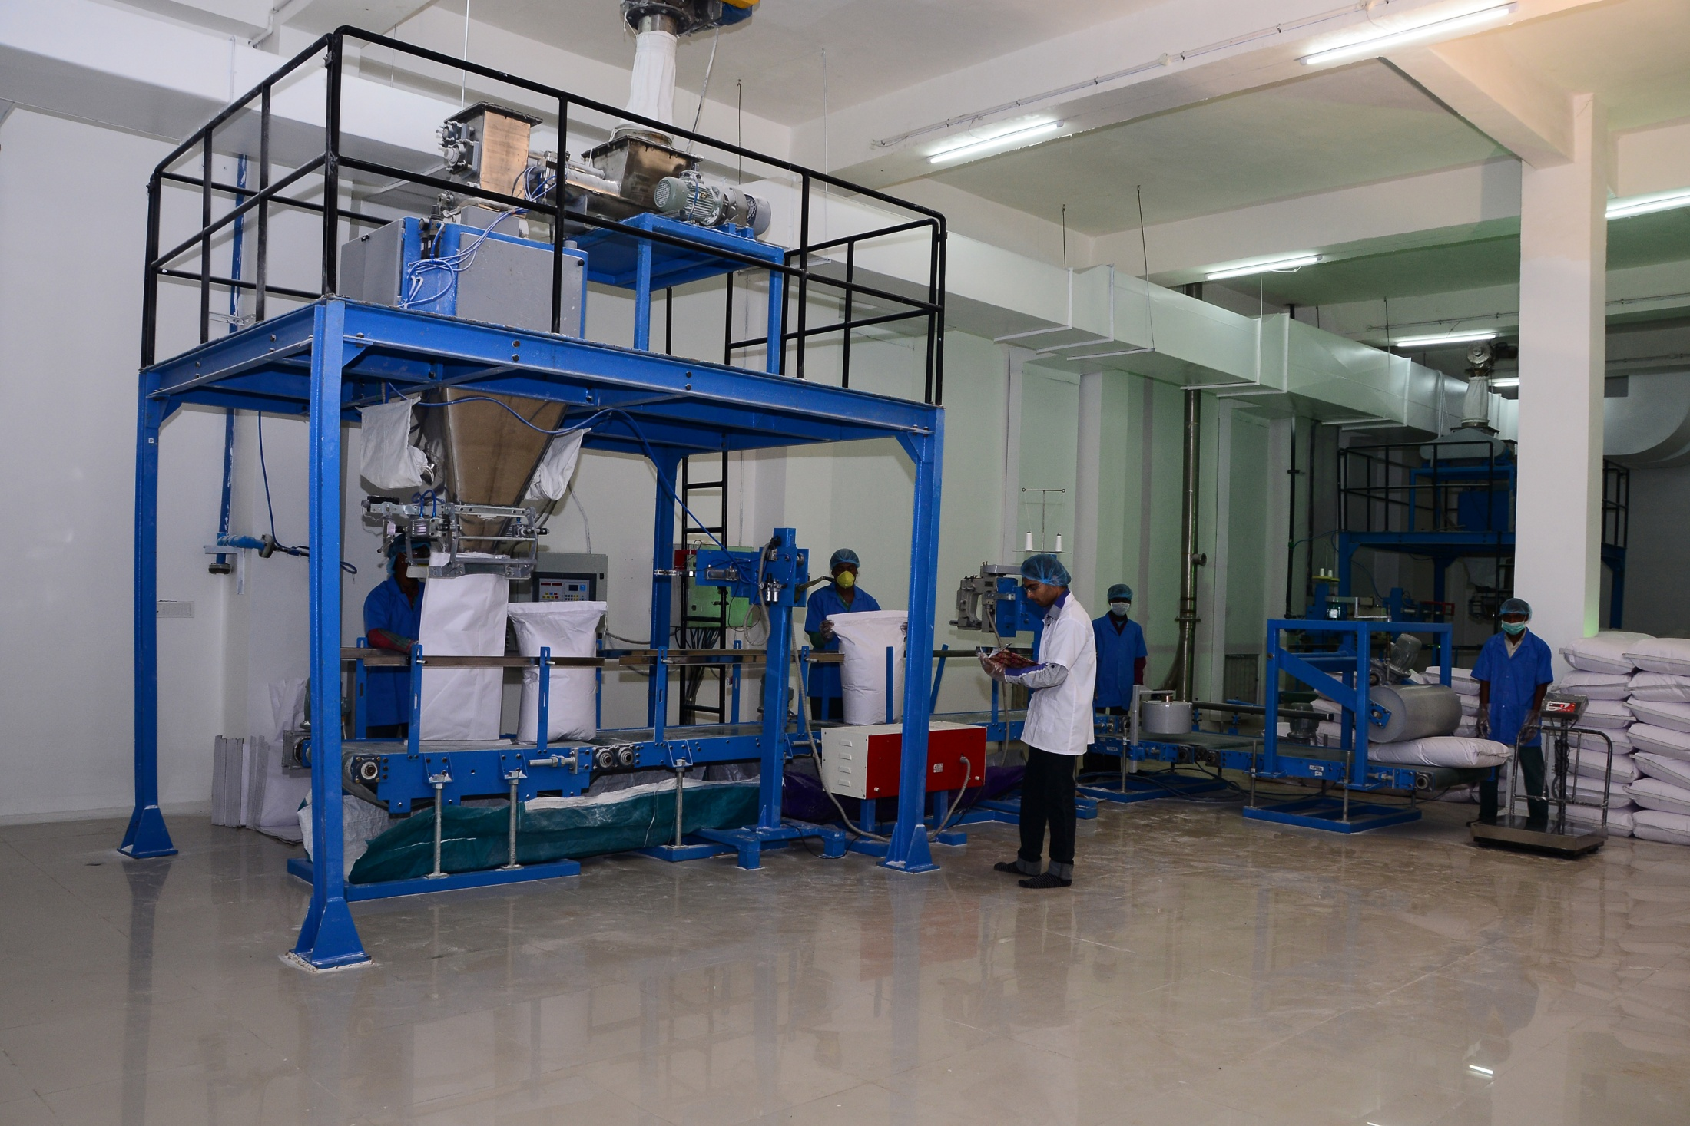
Packing Area
38

Slide 39
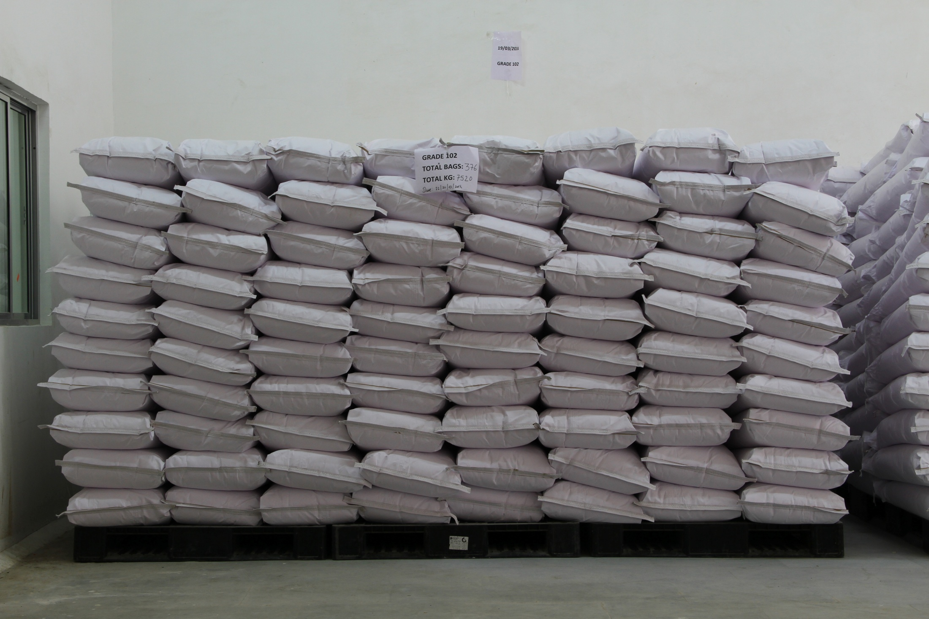
Finished Packing
39

Slide 40
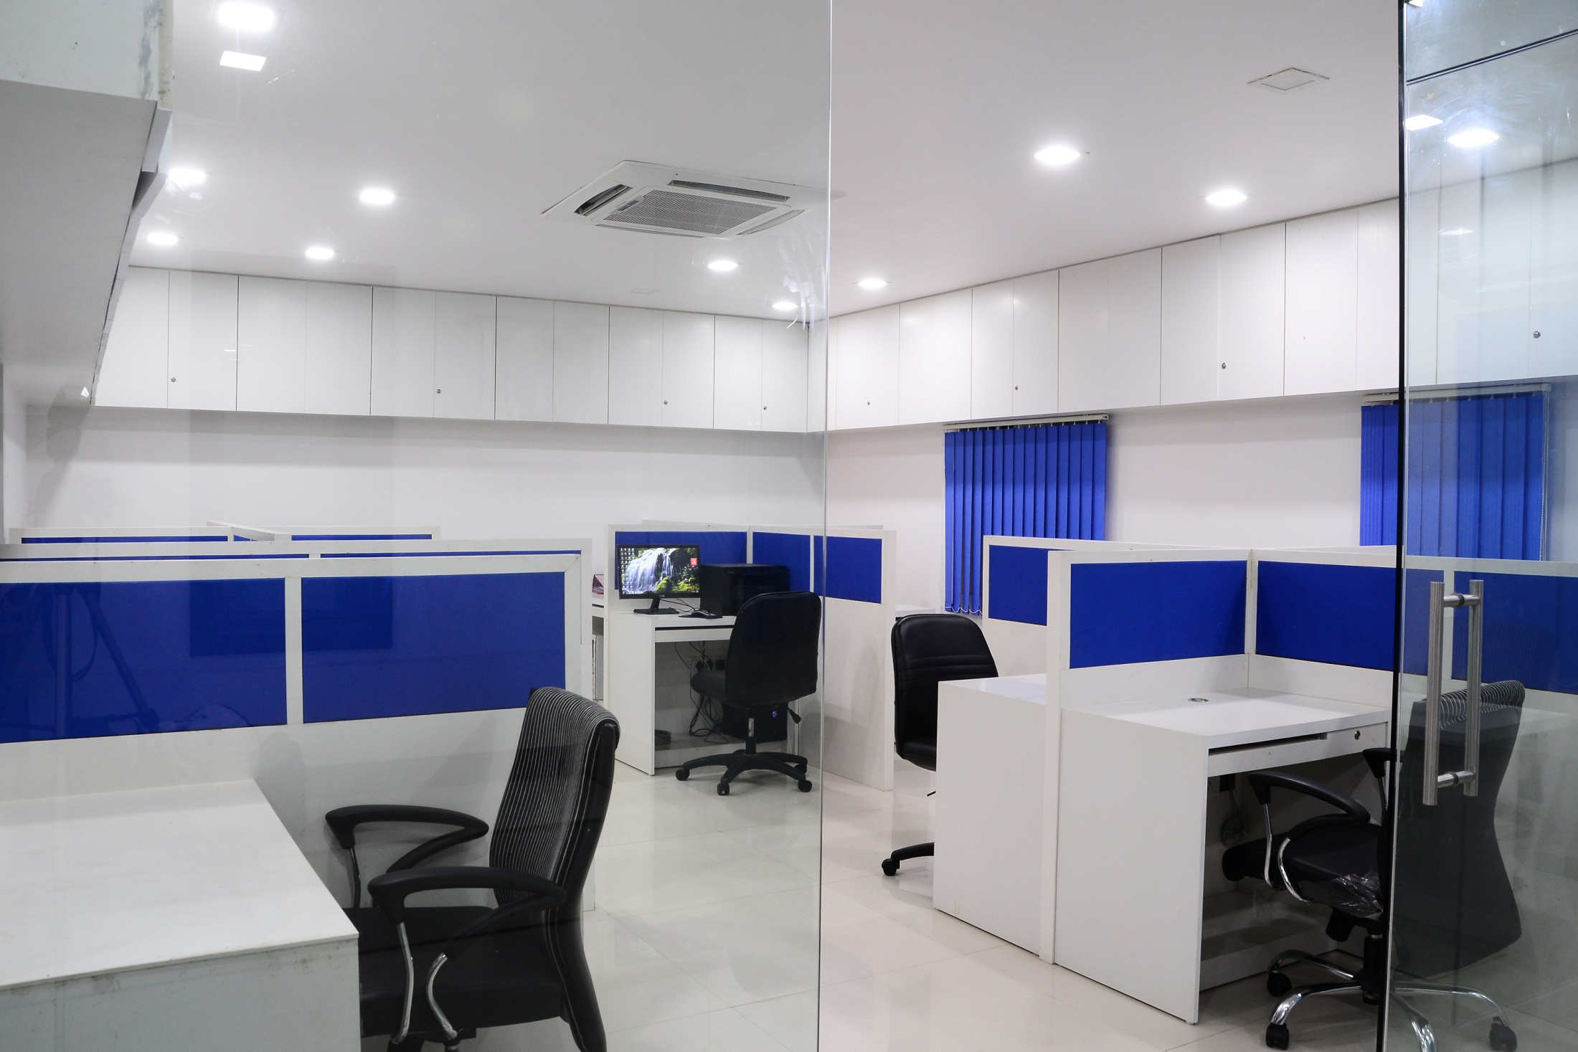
Work Station
40

Slide 41
Conference Room
41

Slide 42
WHY ACCENT
Production Capacity of 12000 MT/Annum.
Leading Manufacturing of Pharmaceutical Excipients – Microcrystalline Cellulose, Croscarmellose Sodium, and Magnesium Stearate along with Cellulose Powder.
Having Quality standard as per ISO & GMP guideline.
Using best quality Alpha Cellulose, Dissolving Rayon Grade wood pulp to attain best Quality.
Customized product development option available as per end-user requirement.
Various export worthy packaging options available depending on customer request.
Regular Technology upgradation.
Having Glass line Reactor in manufacturing.
Having ISO 9001:2015; Halal; Kosher; GMP Certification.
Active presence in more than 75 countries. i.e. USA; Europe; Latin America; Far East Regions
Having over 50 business partner world-wide.
Having modern classed RCC structure under controlled airflow supplied with clean filtered air.
Having separate Physical, Chemical and Microbial sections for Analysis with well qualified and experienced team
42

Slide 43
Corporate Office
Accent Microcell Privite Limited
314, Shangrilla Arcade, Shyamal Cross Roads,
Anandnagar Road, Satellite,
Ahmedabad - 380015, Gujarat, India
Phone.: +91 79 40042367/32459689/
32522633/40094906
Fax No.: +91 79 4009 4907
Email:
info@accentmicrocell.com
bus_intl@accentmicrocell.com
Unit 1 (Pirana)
Survey No. 533/P, Paldi, Kankaj,
Pirana Road, Ta. Daskroi,
Dist. Ahmedabad - 382425
Phone: +91 2718 288001/288002
Unit 2 (Dahej - SEZ)
Plot No. Z/59-60-63, Dahej-SEZ, Part-I,
Ta. Vagra, Dist. Bharuch - 392130
Phone: +91 75758 05960
www.accentmicrocell.com
Thank You!

